Slide 1
MMA 860 The Acquisition and Management of Data
Master of Management Analytics Session Five Alex Scott
Refreshed for 2027W – see syllabus and cheat sheet repository for updated materials.

Slide 2
Today's Objectives
Topic One: Hypothesis Testing
Regression hypothesis testing
Approaches to testing
Tests of multiple restrictions
The Chow Test
The Breusch Pagan Test
Topic Two: The final test

Slide 3
Hypothesis Testing

Slide 4
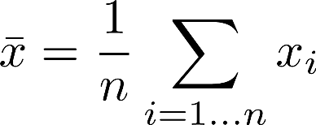




Hypothesis Testing in Three Parts
Sample Distribution
Sample
Mean
By CLT:
Sampling Distribution
of Sample Mean
Can Assess Probabilities

Slide 5
Types of Errors
Consider a jury example, we can think of these errors as representing the following:
From a business context, we can think of these errors as representing the following costs/risks:
Type I error: convicting an innocent person (I thought the evidence pointed to guilt, but in reality the person was innocent.)
Type II error: a guilty defendant is acquitted (I didn't think the evidence pointed to guilt, but in reality the person was guilty.)
Type I error: cost of failure, where I launch a business that turns out not to be successful (I thought the conditions where right, but in reality they were not.)
Type II error: an opportunity cost, where I don't launch a business that would have been successful (I didn't think the conditions were right, but in reality they were.)
Notes:
Type I: reject a true null
Type II: accept a false null

Slide 6
Tests and Errors
Given the Null is True
Type I error (α) (area in red)
The more willing we are to risk a type I error, the less risk of a type II error.
Rejection Region (α)
Rejection Region (larger α)
μ_{H0}
μ_{H0}
Given Null is False
Type II error (β) area in blue
μ_{H0}
μ_{H0}

Slide 7
Tests and Errors
Given the Null is True
The further the true parameter value is from that assumed by the null, the smaller the probability of a type II error.
μ_{H0}
Given the Null is False
μ_{H0}
μ_{True}
μ_{H0}
μ_{True}

Slide 8
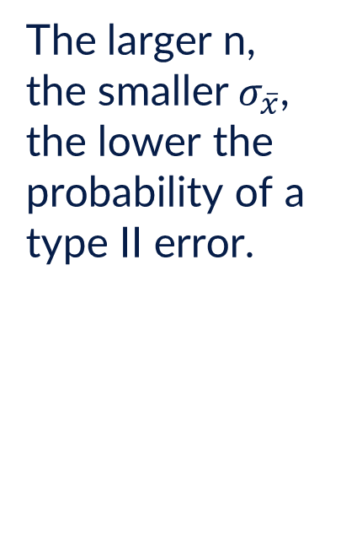
Tests and Errors
Given the Null is True
Type I error (α) (area in red)
The larger n, the smaller$σ_{\overline{x}}$, the lower the probability of a type II error.
Rejection Region (α)
Rejection Region (α)
μ_{H0}
μ_{H0}
Given Null is False
Type II error (β) area in blue
μ_{H0}
μ_{H0}

Slide 9
This Brings Us to Power
Power represents the probability of rejecting the null hypothesis when it is false. The power of a test is defined as 1– β.
The power of a test depends on how far the true parameter value is from that assumed by the null hypothesis. The distance between the null hypothesis value and the truth is called the effect size.
Power increases as n↑; effect size↑; α↑; σ↓.
H₀ | True | False
Reject | Type I | power
Do Not Reject |  | Type II

Slide 10
Simple Hypothesis Testing in Regression
You have already seen the simplest hypothesis testing in regression: the t-test on beta coefficients…
Let us consider a slightly more complicated test, as in the Hypothesis Testing cheat sheet.

Slide 11
Advanced Hypothesis Testing
Some key concepts:
New distributions (optional math details)
Simple versus compound tests
Exact versus asymptotic versus simulated tests
Hypothesis tests as restrictions on a model

Slide 12
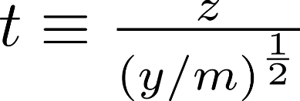
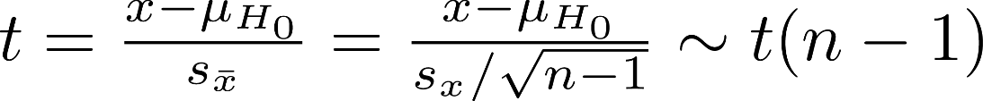
More Advanced Hypothesis Testing – Distributions
The t-distribution
A standard normal divided by the square-root of a chi-squared random variable divided by its degrees of freedom has a t-distribution with the same number of degrees of freedom as the chi-squared:
The t-distribution looks like a shorter, wider version of the normal. As .
The basic t-test used above is based on this result.

Slide 13

More Advanced Hypothesis Testing – Distributions
The F-distribution
The ratio of two chi-squared random variables, each divided by their degrees of freedom has an F-distribution.

Slide 14
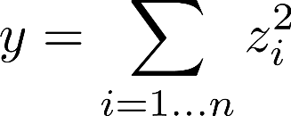




More Advanced Hypothesis Testing – Distributions
The Chi-squared distribution
The sum of m squared independent standard normal variables is a chi-squared variable with m degrees of freedom:
This is particularly relevant for standardized errors since under the NID assumptions of error terms, so and the product of the vectors
The sum of two chi-squared(m) variables is a chi-squared(n) variable with degrees of freedom m + n.

Slide 15

Testing Multiple Restrictions Assuming NID Errors
Suppose we have a standard model with 6 independent variables:
We would like to show, at alpha = 5% that some combination of the independent variables X4..X6 had an impact on the results. We construct the test:
You might think of using individual t-tests on don't. Some people who have taken 'stats 101' think this the right thing to do, sadly, they are wrong.

Slide 16
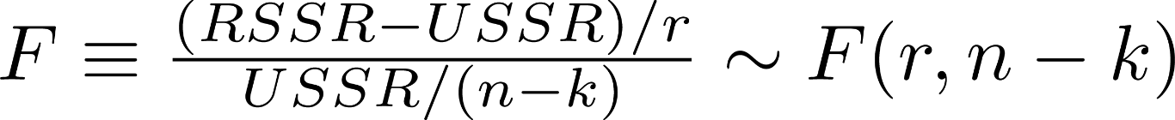
Testing Multiple Restrictions Assuming NID Errors
One correct approach is to estimate both the restricted and unrestricted models and to retain their sum of squared residuals.
In general, one can show that:
When we have r restrictions, n observations and k independent variables.

Slide 17



Generalizing Those Results
The approach we just took can be generalized to many sets of linear restrictions:
We can also do tests with inequality constraints:

Slide 18
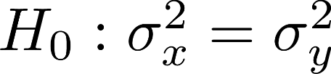
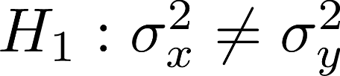
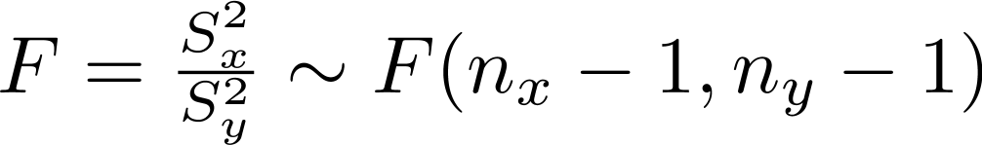
Test for Equality of Variances
We may need to consider a test for the equality of variances between two samples. This could arise as part of a t-test, as it did in principle during MMA 863.
The test takes the form:

Slide 19

The Chow Test
The Chow test is a particular version of this type of test, based on applying the test to two separate data sets. The data sets may be separated by time or by group.
For example, you could determine if some relationship changed over time; or was different across different elements of the population. For example, given:
Do male and female customers respond the same:

Slide 20
Example
Let's do an example following the chow test cheat sheet.

Slide 21
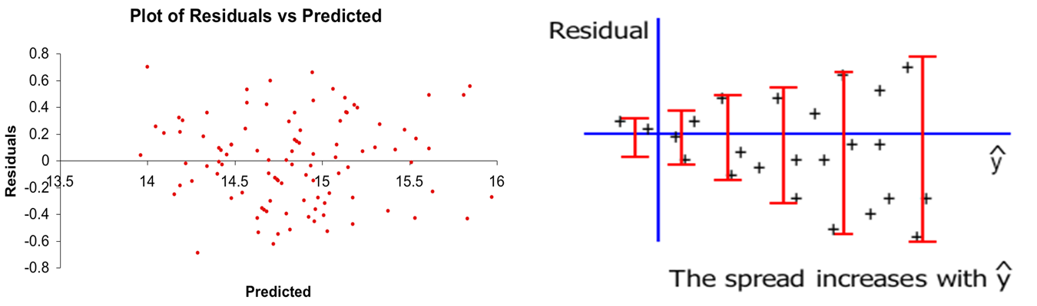
Heteroskedasticity and Testing
Recall heteroskedasticity is a non-uniform variance of the error terms. You can sometimes visualize it with a residual plot.
Heteroskedasticity does not bias estimates, but it makes them inefficient and violates the assumptions we have used for hypothesis testing. This makes the parameter estimates sloppy and the hypotheses tests unreliable.

Slide 22
Testing for Heteroskedasticity
You should always consider the possibility of heteroskedasticity:
For some models, there are good reasons to suspect heteroskedasticity and its potential form. For example, where the independent variables link to 'things' of different sizes (company investments, country characteristics).
As we have seen, heteroskedasticity can be assessed using an 'eyeball test'. Basically, plot the residuals versus Y-hat and the X-variables. This is a good place to start, but a bad place to stop.
Breusch–Pagan test for heteroskedasticity

Slide 23
Example
Review/do the cheat sheet on heteroscedasticity testing.

Slide 24
Key Points
You should be able to interpret output, assess models, run tests, etc. in a multiple regression context.
You should be able to perform simultaneous tests on multiple parameters.
You should understand that there are extensions to the basic testing methods and their limitations.
You should be able to test for structural change.
You should understand and be able to test and address the problems created by heteroscedasticity.

Slide 25
The Last Test
We've talked about test/train data – now let's learn how to use it.
Let's do the Predicting Results Cheat Sheet.

Slide 26
Pulling it All Together
We have discussed quite a bit over the last 5 classes:
How to get data ready for modelling
How to visualize data, and tell a story with data
How to run a regression
How to assess and test a regression
How to test other hypotheses as part of a regression
Now, we should talk about how to bring it all together to solve a business problem.

Slide 27
The Modelling Process
Model Development
Data Collection
Estimation
Testing/Assessing
Conclusions

Slide 28
Answering Business Questions
Regressions are just one type of predictive model, and a predictive model is just one tool to help with solving business problems.
This tool can be used in a number of ways:
A point estimate for a specific set of parameters
Gaining a deeper understanding of how an environmental or business factor affects an outcome variable
Gaining a deeper understanding of the underlying process(es) that explains an outcome variable

Slide 29
Point Estimates
As we have discussed, the output of a regression model are coefficients associated with independent variables. The coefficients are used to build out an equation, and allow you to create point estimates for your dependent variable.
A model might be:
We can plug in the values we care about (HP and # Doors) to get a point estimate. In this case, a 300 HP car with 2 doors should cost $36,000, while a 190 HP car with 4 doors should cost $21,000.
Car Price = $10,000 + 100* Engine HP – 2000 * # Doors

Slide 30
Single Variable Factors
There are some business problems that can be solved by understanding how a change in a single variable impacts our outcome.
For this, we can examine the magnitude and direction of any given coefficient and understand the change. A widely used example in banking is that of interest rates and their effects on lending and deposit portfolios.

Slide 31
Underlying Processes
A well built model gives insight into an underlying process that explains an outcome variable. Sometimes it is important to understand more than a single variable's impact, but instead a broader picture.
For example, there are multiple factors that might predict a person's propensity for purchasing a mortgage. You want to understand all of those to target the right people.
What characteristics would you look for in someone before marketing a mortgage to them?

Slide 32
Communicating It
Based on the business problem you are trying to solve you should be able to use the understanding gained from one or more of these techniques to provide more insight.
Now, how do we communicate this to a business audience?

Slide 33
Communicating It
Depending on your audience you will have to present your results differently.
Analysts and Data Scientists will want detailed statistical output as well as the business implications.
Executives will want you to satisfy their analysts and data scientists, but will be much more concerned with the explainability of your results.

Slide 34
How Data Scientists Assess Models:
Does it solve the business problem?
Is it easy to understand?
Are the coefficients intuitive?
Model plots (predicted versus actual, residuals)
Cumulative gains chart (for classification models)
Train versus test results

Slide 35
How Executives Assess Analytics Solutions:
Does it solve the business problem?
Does it validate my previous thinking? (be careful here)
Is it easy to understand?
Do the directions of coefficients make sense?
Do my analysts believe it?

Slide 36
Convincing People to Make Change
How do you convince people to make change in your organization now?
How would you change your approach if you had data or an analytical model?

Slide 37
That's Enough for Today

Slide 38
Sample Question 1
It is widely believed that the transit's system revenue has been trending up over the course of the year, subject to the fact that sales are normally lower in the months of July and August, however, there are those that believe that somewhere around the beginning of May, the rate of growth increased significantly. Like most businesses, advertising budget and the cost of alternatives (i.e., gasoline for car commutes) should also play a role. Consider each of the issues below in isolation and construct a fairly complete test of each of them alone (i.e., do not attempt to build a single model to test all these things simultaneously.)
That there is an upwards trend in transit revenue as a function of time and that this trend has increased since early May.
Do advertising budget and gasoline each have the anticipated impact on transit revenue?
Is there evidence that the impact of gasoline price and advertising budget are somehow different in the summer, controlling for the 'summer effect' with dummy variables?

Slide 39
Sample Question 2
Consider the data on the tab Structural_Change_Data which has data on Canadian and American respondents.
Build a model to explain Y using the X1..X4 variables and the US dummy. Does being a US respondent appear to explain the results? If it does not, does that mean that Canadians and Americans are the same?
Run a model to explain Y using X1..X4 then perform a test to determine if Canadians and Americans are in fact the same based or different. Explain the results.
Without checking the data, what differences, in principle, could still exist between Canadians and Americans?

Slide 40
Appendix: Three Classical Testing Methods

Slide 41
Exact versus Asymptotic Tests
Exact tests are based on strict assumptions – such as the error term is normally distributed. When these assumptions do not hold, we can still conduct tests based on asymptotic theory.
Asymptotic tests are based on some important statistical ideas:
Laws of Large Numbers – for many distributions, sample means tend to population averages as samples tend to infinity.
Central Limits Theorems – for many distributions, sampling distributions of sample means tend to normal distributions.

Slide 42
Revisiting the Previous Tests
There are asymptotic versions of the t and F tests that we previously encountered which are based on weaker assumptions.
This means that, provided samples are sufficiently large, these tests will remain appropriate even if the initial error distributions are not normal.
We have seen tests based on t and F, but here are more forms of tests that one can consider as well…

Slide 43
Three Classical Testing Methods
In addition to the tests you've seen so far, there are three classical approaches to hypothesis testing. They often encountered in a maximum likelihood context:
Likelihood Ratio (LR)
Wald (W)
Lagrange Multiplier (LM)
We are reviewing these for completeness, you do not need to know the mathematics or the formulas. Focus on the principles involved.
Note: For most people, the material in these slides is more than sufficient for our class, however, more details can be found in assigned readings.

Slide 44
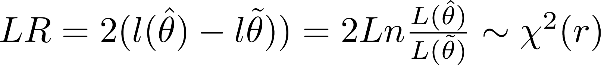
The Likelihood Ratio Test
Recall maximum likelihood estimation…
It turns out that if we estimate both an unrestricted and a model with r restrictions, , the likelihood ratio statistic:
We can use this to conduct hypothesis tests in a ML context, if we can run both restricted and unrestricted models.

Slide 45
The Wald Test
If we have an estimate of the unrestricted model, , we can construct a test statistic for a model with r restrictions using:
This testing method only requires running the unrestricted model. Which may be easier to run than the restricted model in some.
The standard t-test squared would be a Wald test.
Note that Wald test statistics have questionable small sample properties, so use LR tests if the you have a choice.

Slide 46
The Lagrange Multiplier Test
If we have an estimate of the restricted model, , we can construct a test using only the restricted model by determining how tightly binding those restrictions are.
Where is the vector of gradients and is the matrix of partial derivatives of the loglikelihood function.
This method can be useful when the restricted models can be run but unrestricted would be difficult to run.

Slide 47
Limitations of Asymptotic Tests
Asymptotic tests assume that sufficiently large samples have the properties of infinite samples. There are caveats to this:
You may not know when large enough really is large enough
You may have a small sample that is not normal
So, what can you do?

Slide 48
Small Samples and Dubious Assumptions
Besides the obvious, get more data, there are a few things you can consider when faced with small samples and dubious distributional assumptions:
Monte Carlo analysis
Bootstrapping
Transforming variables
Note: Transforming variables is described in Using Multivariate Statistics. This will be covered in a later course.

Slide 49
Monte Carlo Analysis
In general, a Monte Carlo analysis is conducted by generating a large collection of 'sample data' according to a DGP of interest, typically the one implied by the null hypothesis:
If the DGP of the null is used, the resulting samples can be used to calculate a distribution of test statistics to perform a hypothesis test.
More generally, the resulting samples can be used to analyze the properties of the test statistics. For example, how often does an asymptotic model reject for a given alpha; or how well does it perform under a variety of alternative hypotheses.

Slide 50
Bootstrapping
Bootstrapping is a process whereby many samples of size n with replacement are constructed 'under the null'. Each sample is used to calculate a test statistic. The resulting empirical distribution of test statistics approximates the true distribution of test statistics 'under the null' and can be used to perform hypothesis tests.
There are frequently multiple ways to implement bootstrapping. Some use parameterizations of the distribution, others do not.
Typically, you must program them yourself. The programming is not hard but replicating the null may be.
They typically perform very well per Monte Carlo studies.

Slide 51
Appendix: Heteroscedasticity Math

Slide 52
Heteroskedasticity
Recall our previous finding that, under normal error terms:
In the presence of heteroskedasticity, this is no longer true, rather:
Which is called a 'sandwich' covariance matrix because of the matrix being sandwiched in the middle of it.
Naturally, having the wrong variance estimates gives rise to invalid hypothesis tests.
so

Slide 53
AI tips: Hypothesis testing, Chow tests, heteroskedasticity
Use AI to accelerate, not replace, your thinking.
Good prompts
Less useful prompts
"Given this Wald test syntax [paste], explain what null hypothesis I'm actually testing."
"My Breusch-Pagan p-value is 0.03 — what does that mean for my inference?"
"Translate this business question into a Chow test setup."
"What's the difference between HC0/HC1/HC2/HC3 standard errors?"
"Tell me whether to reject the null."
"What's the right p-value threshold?" (it's a judgment call)
"Just fix my model."

Slide 54
Bringing it all together
A checklist for any regression project.
✓
Did you frame the right business question?
✓
Did you understand and clean the data before modelling?
✓
Did you pick the right technique, and can you justify it?
✓
Did you run all four diagnostic plots and act on them?
✓
Did you check for heteroskedasticity and apply HC3 if needed?
✓
Did you test for structural breaks if your data has time or subgroups?
✓
Did you split train/test (or document why you didn't)?
✓
Did you communicate the result in business terms, not just statistics?

